Slide 1


Semantic Chunk Sparse Attention for Large Language Model
Department of Mathematics Computational Sci & Eng
Mingyuan Chi
Advisor: Prof.Dr. Torsten Hoefler,
Dr. Maciej Besta, Dr. Grzegorz Kwasniews
Master Thesis
18. Sep 2024, Zürich
INTERAL
Notes:
Hello everyone,
I’m Mingyuan Chi,
Welcome to today’s defense for my master thesis on semantic chunk sparse attention for large language model

Slide 2
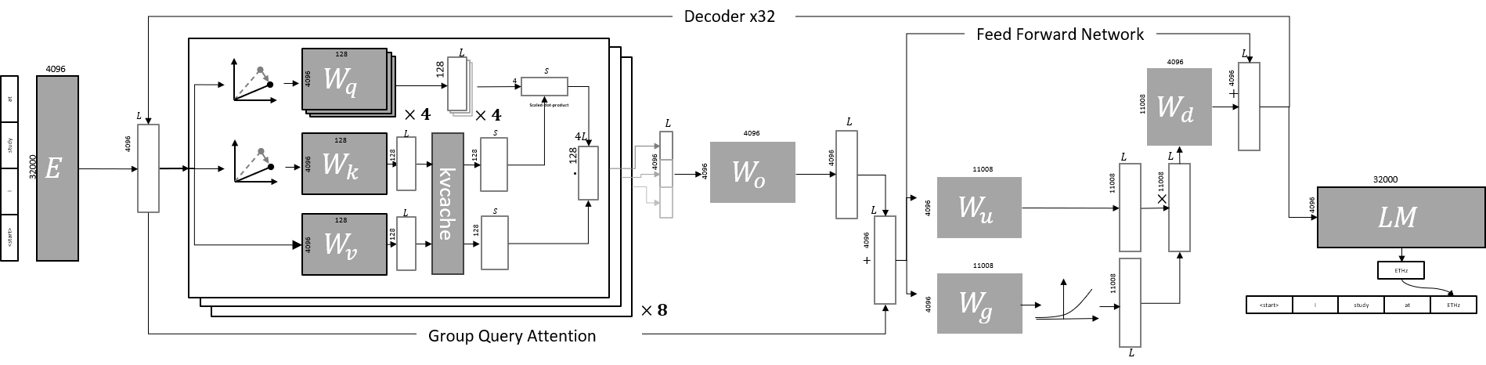
Introduction
Overview of Llama3-8B
Notes:
To begin with,
I’ll introduce what’s going on inside the Large Language Model in the text generation task.
Here is an overview of the Llama3 -8B model
It has 32 decoder layers and Group Query Attention with
8 heads and 4 query per key

Slide 3
Introduction
<start>
I
study
LLM Generation
Embedding
Notes:
For instance,
Firstly, the text is tokenized into tokens and encoded to latent space by the embedding layer

Slide 4
Introduction
LLM Generation
Embedding
<start>
I
study
Notes:
For instance,
Firstly, the text is tokenized into tokens and encoded to latent space by the embedding layer

Slide 5
Introduction
LLM Generation
<start>
I
study
Notes:
For instance,
Firstly, the text is tokenized into tokens and encoded to latent space by the embedding layer

Slide 6
Introduction
LLM Generation
<start>
I
<start>
I
study
<start>
I
study
study
Notes:
Then, in the attention part, the latent space vector is transformed by three projections,
Which is query projection, key projection and value projection

Slide 7



Introduction
LLM Generation
<start>
I
study
<start>
I
study
<start>
I
study
$$W_{q}^{1}$$
$$W_{k}^{1}$$
$$W_{v}^{1}$$
Notes:
Then, in the attention part, the latent space vector is transformed by three projections,
Which are query projection, key projection and value projection

Slide 8
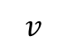

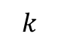
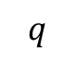


Introduction
LLM Generation
$$W_{q}^{1}$$
$$W_{k}^{1}$$
$$W_{v}^{1}$$
$$q$$
<start>
I
study
$$k$$
<start>
I
study
$$v$$
<start>
I
study
Notes:
After that, we got the query,key,value vectors for the self attention

Slide 9
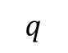
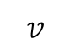
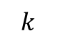
Introduction
<start>
I
study
LLM Generation
$$v$$
$$k$$
<start>
I
study
$$q$$
<start>
I
study
Notes:
Then we applied the scaled dot product

Slide 10
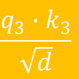
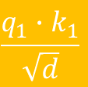


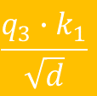

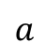
Introduction
<start>
I
study
LLM Generation
$$v$$
$$k$$
<start>
I
study
$$q$$
<start>
$$\frac{q_{1}∙k_{1}}{\sqrt{d}}$$
$$a$$
I
$$\frac{q_{2}∙k_{1}}{\sqrt{d}}$$
$$\frac{q_{2}∙k_{2}}{\sqrt{d}}$$
study
$$\frac{q_{3}∙k_{1}}{\sqrt{d}}$$
$$\frac{q_{3}∙k_{2}}{\sqrt{d}}$$
$$\frac{q_{3}∙k_{3}}{\sqrt{d}}$$
Notes:
Then we applied the scaled dot product
The “d” here is the dimension of the vector
“a” represent the attention matrix

Slide 11
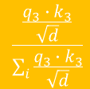
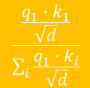
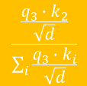
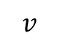

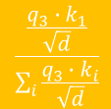

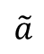
Introduction
<start>
I
study
LLM Generation
$$v$$
$$k$$
<start>
I
study
$$q$$
<start>
$$\frac{\frac{q_{1}{∙k}_{1}}{\sqrt{d}}}{\sum_{i}{\frac{q_{1}{∙k}_{i}}{\sqrt{d}}}}$$
$$\tilde{a}$$
I
$$\frac{\frac{q_{2}{∙k}_{1}}{\sqrt{d}}}{\sum_{i}{\frac{q_{2}{∙k}_{i}}{\sqrt{d}}}}$$
$$\frac{\frac{q_{2}{∙k}_{2}}{\sqrt{d}}}{\sum_{i}{\frac{q_{2}{∙k}_{i}}{\sqrt{d}}}}$$
study
$$\frac{\frac{q_{3}{∙k}_{1}}{\sqrt{d}}}{\sum_{i}{\frac{q_{3}{∙k}_{i}}{\sqrt{d}}}}$$
$$\frac{\frac{q_{3}{∙k}_{2}}{\sqrt{d}}}{\sum_{i}{\frac{q_{3}{∙k}_{i}}{\sqrt{d}}}}$$
$$\frac{\frac{q_{3}{∙k}_{3}}{\sqrt{d}}}{\sum_{i}{\frac{q_{3}{∙k}_{3}}{\sqrt{d}}}}$$
softmax
Notes:
Then, we apply the softmax in row direction
We called the attention matrix after the softmax “a tilde”

Slide 12
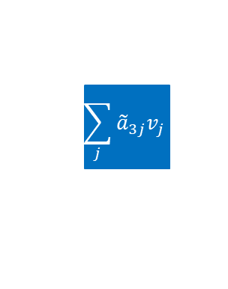

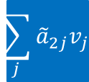


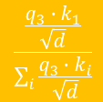
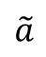


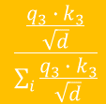
Introduction
<start>
I
study
LLM Generation
$$v$$
$$k$$
<start>
I
study
$$q$$
<start>
$$\frac{\frac{q_{1}{∙k}_{1}}{\sqrt{d}}}{\sum_{i}{\frac{q_{1}{∙k}_{i}}{\sqrt{d}}}}$$
$$\sum_{j}{{\tilde{a}}_{1j}v_{j}}$$
$$\tilde{a}$$
I
$$\frac{\frac{q_{2}{∙k}_{1}}{\sqrt{d}}}{\sum_{i}{\frac{q_{2}{∙k}_{i}}{\sqrt{d}}}}$$
$$\frac{\frac{q_{2}{∙k}_{2}}{\sqrt{d}}}{\sum_{i}{\frac{q_{2}{∙k}_{i}}{\sqrt{d}}}}$$
$$\sum_{j}{{\tilde{a}}_{2j}v_{j}}$$
study
$$\frac{\frac{q_{3}{∙k}_{1}}{\sqrt{d}}}{\sum_{i}{\frac{q_{3}{∙k}_{i}}{\sqrt{d}}}}$$
$$\frac{\frac{q_{3}{∙k}_{2}}{\sqrt{d}}}{\sum_{i}{\frac{q_{3}{∙k}_{i}}{\sqrt{d}}}}$$
$$\frac{\frac{q_{3}{∙k}_{3}}{\sqrt{d}}}{\sum_{i}{\frac{q_{3}{∙k}_{3}}{\sqrt{d}}}}$$
$$\sum_{j}{{\tilde{a}}_{3j}v_{j}}$$
FFN+linear
Notes:
Then, the weighted sum of values becomes the output for the self attention

Slide 13


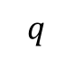
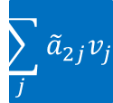


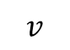
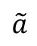

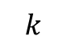

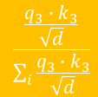
Introduction
<start>
I
study
<start>
LLM Generation
$$v$$
<start>
I
study
$$k$$
$$q$$
<start>
$$\frac{\frac{q_{1}{∙k}_{1}}{\sqrt{d}}}{\sum_{i}{\frac{q_{1}{∙k}_{i}}{\sqrt{d}}}}$$
$$\sum_{j}{{\tilde{a}}_{1j}v_{j}}$$
FFN
$$\tilde{a}$$
I
$$\frac{\frac{q_{2}{∙k}_{1}}{\sqrt{d}}}{\sum_{i}{\frac{q_{2}{∙k}_{i}}{\sqrt{d}}}}$$
$$\frac{\frac{q_{2}{∙k}_{2}}{\sqrt{d}}}{\sum_{i}{\frac{q_{2}{∙k}_{i}}{\sqrt{d}}}}$$
$$\sum_{j}{{\tilde{a}}_{2j}v_{j}}$$
study
$$\frac{\frac{q_{3}{∙k}_{1}}{\sqrt{d}}}{\sum_{i}{\frac{q_{3}{∙k}_{i}}{\sqrt{d}}}}$$
$$\frac{\frac{q_{3}{∙k}_{2}}{\sqrt{d}}}{\sum_{i}{\frac{q_{3}{∙k}_{i}}{\sqrt{d}}}}$$
$$\frac{\frac{q_{3}{∙k}_{3}}{\sqrt{d}}}{\sum_{i}{\frac{q_{3}{∙k}_{3}}{\sqrt{d}}}}$$
$$\sum_{j}{{\tilde{a}}_{3j}v_{j}}$$
Notes:
After that, we apply the Feed forward Network to get the hidden states for the next prediction

Slide 14
Introduction
<start>
I
study
<start>
LLM Generation
$$v$$
<start>
I
study
$$k$$
$$q$$
<start>
$$\frac{\frac{q_{1}{∙k}_{1}}{\sqrt{d}}}{\sum_{i}{\frac{q_{1}{∙k}_{i}}{\sqrt{d}}}}$$
FFN
I
$$\tilde{a}$$
I
$$\frac{\frac{q_{2}{∙k}_{1}}{\sqrt{d}}}{\sum_{i}{\frac{q_{2}{∙k}_{i}}{\sqrt{d}}}}$$
$$\frac{\frac{q_{2}{∙k}_{2}}{\sqrt{d}}}{\sum_{i}{\frac{q_{2}{∙k}_{i}}{\sqrt{d}}}}$$
study
study
$$\frac{\frac{q_{3}{∙k}_{1}}{\sqrt{d}}}{\sum_{i}{\frac{q_{3}{∙k}_{i}}{\sqrt{d}}}}$$
$$\frac{\frac{q_{3}{∙k}_{2}}{\sqrt{d}}}{\sum_{i}{\frac{q_{3}{∙k}_{i}}{\sqrt{d}}}}$$
$$\frac{\frac{q_{3}{∙k}_{3}}{\sqrt{d}}}{\sum_{i}{\frac{q_{3}{∙k}_{3}}{\sqrt{d}}}}$$
at
Notes:
The output token is supposed to be the next prediction.
Therefore, the token “at” is our next prediction

Slide 15
Introduction
<start>
I
study
<start>
LLM Generation
$$v$$
<start>
I
study
$$k$$
$$q$$
<start>
$$\frac{\frac{q_{1}{∙k}_{1}}{\sqrt{d}}}{\sum_{i}{\frac{q_{1}{∙k}_{i}}{\sqrt{d}}}}$$
FFN
I
$$\tilde{a}$$
I
$$\frac{\frac{q_{2}{∙k}_{1}}{\sqrt{d}}}{\sum_{i}{\frac{q_{2}{∙k}_{i}}{\sqrt{d}}}}$$
$$\frac{\frac{q_{2}{∙k}_{2}}{\sqrt{d}}}{\sum_{i}{\frac{q_{2}{∙k}_{i}}{\sqrt{d}}}}$$
study
at
at
study
$$\frac{\frac{q_{3}{∙k}_{1}}{\sqrt{d}}}{\sum_{i}{\frac{q_{3}{∙k}_{i}}{\sqrt{d}}}}$$
$$\frac{\frac{q_{3}{∙k}_{2}}{\sqrt{d}}}{\sum_{i}{\frac{q_{3}{∙k}_{i}}{\sqrt{d}}}}$$
$$\frac{\frac{q_{3}{∙k}_{3}}{\sqrt{d}}}{\sum_{i}{\frac{q_{3}{∙k}_{3}}{\sqrt{d}}}}$$
at
Notes:
The output token is supposed to be the next prediction.
Therefore, the token “at” is our next prediction

Slide 16


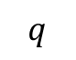



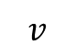


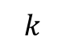
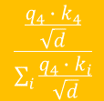
Introduction
<start>
I
study
at
<start>
LLM Generation
$$v$$
<start>
I
study
at
$$k$$
$$q$$
<start>
$$\frac{\frac{q_{1}{∙k}_{1}}{\sqrt{d}}}{\sum_{i}{\frac{q_{1}{∙k}_{i}}{\sqrt{d}}}}$$
$$\tilde{a}$$
I
$$\frac{\frac{q_{2}{∙k}_{1}}{\sqrt{d}}}{\sum_{i}{\frac{q_{2}{∙k}_{i}}{\sqrt{d}}}}$$
$$\frac{\frac{q_{2}{∙k}_{2}}{\sqrt{d}}}{\sum_{i}{\frac{q_{2}{∙k}_{i}}{\sqrt{d}}}}$$
study
$$\frac{\frac{q_{3}{∙k}_{1}}{\sqrt{d}}}{\sum_{i}{\frac{q_{3}{∙k}_{i}}{\sqrt{d}}}}$$
$$\frac{\frac{q_{3}{∙k}_{2}}{\sqrt{d}}}{\sum_{i}{\frac{q_{3}{∙k}_{i}}{\sqrt{d}}}}$$
$$\frac{\frac{q_{3}{∙k}_{3}}{\sqrt{d}}}{\sum_{i}{\frac{q_{3}{∙k}_{3}}{\sqrt{d}}}}$$
at
$$\frac{\frac{q_{4}{∙k}_{1}}{\sqrt{d}}}{\sum_{i}{\frac{q_{4}{∙k}_{i}}{\sqrt{d}}}}$$
$$\frac{\frac{q_{4}{∙k}_{2}}{\sqrt{d}}}{\sum_{i}{\frac{q_{4}{∙k}_{i}}{\sqrt{d}}}}$$
$$\frac{\frac{q_{4}{∙k}_{3}}{\sqrt{d}}}{\sum_{i}{\frac{q_{4}{∙k}_{i}}{\sqrt{d}}}}$$
$$\frac{\frac{q_{4}{∙k}_{4}}{\sqrt{d}}}{\sum_{i}{\frac{q_{4}{∙k}_{i}}{\sqrt{d}}}}$$
Notes:
Again, this time, we only need to consider the last one.
Only the query from the last one contribute to the next prediction.
The keys and values are cached in the generation,

Slide 17

Introduction
<start>
I
study
at
<start>
LLM Generation
$$v$$
<start>
I
study
at
$$k$$
$$q$$
<start>
$$\frac{\frac{q_{1}{∙k}_{1}}{\sqrt{d}}}{\sum_{i}{\frac{q_{1}{∙k}_{i}}{\sqrt{d}}}}$$
$$\tilde{a}$$
I
$$\frac{\frac{q_{2}{∙k}_{1}}{\sqrt{d}}}{\sum_{i}{\frac{q_{2}{∙k}_{i}}{\sqrt{d}}}}$$
$$\frac{\frac{q_{2}{∙k}_{2}}{\sqrt{d}}}{\sum_{i}{\frac{q_{2}{∙k}_{i}}{\sqrt{d}}}}$$
study
$$\frac{\frac{q_{3}{∙k}_{1}}{\sqrt{d}}}{\sum_{i}{\frac{q_{3}{∙k}_{i}}{\sqrt{d}}}}$$
$$\frac{\frac{q_{3}{∙k}_{2}}{\sqrt{d}}}{\sum_{i}{\frac{q_{3}{∙k}_{i}}{\sqrt{d}}}}$$
$$\frac{\frac{q_{3}{∙k}_{3}}{\sqrt{d}}}{\sum_{i}{\frac{q_{3}{∙k}_{3}}{\sqrt{d}}}}$$
at
$$\frac{\frac{q_{4}{∙k}_{1}}{\sqrt{d}}}{\sum_{i}{\frac{q_{4}{∙k}_{i}}{\sqrt{d}}}}$$
$$\frac{\frac{q_{4}{∙k}_{2}}{\sqrt{d}}}{\sum_{i}{\frac{q_{4}{∙k}_{i}}{\sqrt{d}}}}$$
$$\frac{\frac{q_{4}{∙k}_{3}}{\sqrt{d}}}{\sum_{i}{\frac{q_{4}{∙k}_{i}}{\sqrt{d}}}}$$
$$\frac{\frac{q_{4}{∙k}_{4}}{\sqrt{d}}}{\sum_{i}{\frac{q_{4}{∙k}_{i}}{\sqrt{d}}}}$$
$$\sum_{j}{{\tilde{a}}_{3j}v_{j}}$$
Notes:
So the attention matrix here is a 4 by 1 matrix
Again, the same, we got the weighted sum of the past values using the attention matrix

Slide 18
Introduction
<start>
I
study
at
<start>
LLM Generation
$$v$$
<start>
I
study
at
$$k$$
$$q$$
<start>
$$\frac{\frac{q_{1}{∙k}_{1}}{\sqrt{d}}}{\sum_{i}{\frac{q_{1}{∙k}_{i}}{\sqrt{d}}}}$$
$$\tilde{a}$$
I
$$\frac{\frac{q_{2}{∙k}_{1}}{\sqrt{d}}}{\sum_{i}{\frac{q_{2}{∙k}_{i}}{\sqrt{d}}}}$$
$$\frac{\frac{q_{2}{∙k}_{2}}{\sqrt{d}}}{\sum_{i}{\frac{q_{2}{∙k}_{i}}{\sqrt{d}}}}$$
study
$$\frac{\frac{q_{3}{∙k}_{1}}{\sqrt{d}}}{\sum_{i}{\frac{q_{3}{∙k}_{i}}{\sqrt{d}}}}$$
$$\frac{\frac{q_{3}{∙k}_{2}}{\sqrt{d}}}{\sum_{i}{\frac{q_{3}{∙k}_{i}}{\sqrt{d}}}}$$
$$\frac{\frac{q_{3}{∙k}_{3}}{\sqrt{d}}}{\sum_{i}{\frac{q_{3}{∙k}_{3}}{\sqrt{d}}}}$$
at
$$\frac{\frac{q_{4}{∙k}_{1}}{\sqrt{d}}}{\sum_{i}{\frac{q_{4}{∙k}_{i}}{\sqrt{d}}}}$$
$$\frac{\frac{q_{4}{∙k}_{2}}{\sqrt{d}}}{\sum_{i}{\frac{q_{4}{∙k}_{i}}{\sqrt{d}}}}$$
$$\frac{\frac{q_{4}{∙k}_{3}}{\sqrt{d}}}{\sum_{i}{\frac{q_{4}{∙k}_{i}}{\sqrt{d}}}}$$
$$\frac{\frac{q_{4}{∙k}_{4}}{\sqrt{d}}}{\sum_{i}{\frac{q_{4}{∙k}_{i}}{\sqrt{d}}}}$$
FFN
ETHz
Notes:
The same way, we got the next token, which is “ETHz”

Slide 19
Introduction
<start>
I
study
at
<start>
LLM Generation
$$v$$
<start>
I
study
at
$$k$$
$$q$$
<start>
$$\frac{\frac{q_{1}{∙k}_{1}}{\sqrt{d}}}{\sum_{i}{\frac{q_{1}{∙k}_{i}}{\sqrt{d}}}}$$
$$\tilde{a}$$
I
$$\frac{\frac{q_{2}{∙k}_{1}}{\sqrt{d}}}{\sum_{i}{\frac{q_{2}{∙k}_{i}}{\sqrt{d}}}}$$
$$\frac{\frac{q_{2}{∙k}_{2}}{\sqrt{d}}}{\sum_{i}{\frac{q_{2}{∙k}_{i}}{\sqrt{d}}}}$$
study
$$\frac{\frac{q_{3}{∙k}_{1}}{\sqrt{d}}}{\sum_{i}{\frac{q_{3}{∙k}_{i}}{\sqrt{d}}}}$$
$$\frac{\frac{q_{3}{∙k}_{2}}{\sqrt{d}}}{\sum_{i}{\frac{q_{3}{∙k}_{i}}{\sqrt{d}}}}$$
$$\frac{\frac{q_{3}{∙k}_{3}}{\sqrt{d}}}{\sum_{i}{\frac{q_{3}{∙k}_{3}}{\sqrt{d}}}}$$
FFN
ETHz
ETHz
at
$$\frac{\frac{q_{4}{∙k}_{1}}{\sqrt{d}}}{\sum_{i}{\frac{q_{4}{∙k}_{i}}{\sqrt{d}}}}$$
$$\frac{\frac{q_{4}{∙k}_{2}}{\sqrt{d}}}{\sum_{i}{\frac{q_{4}{∙k}_{i}}{\sqrt{d}}}}$$
$$\frac{\frac{q_{4}{∙k}_{3}}{\sqrt{d}}}{\sum_{i}{\frac{q_{4}{∙k}_{i}}{\sqrt{d}}}}$$
$$\frac{\frac{q_{4}{∙k}_{4}}{\sqrt{d}}}{\sum_{i}{\frac{q_{4}{∙k}_{i}}{\sqrt{d}}}}$$
ETHz
Notes:
The same way, we got the next token, which is “ETHz”

Slide 20





Introduction
<start>
I
study
at
ETHz
<start>
LLM Generation
$$v$$
<start>
I
study
at
ETHz
$$k$$
$$q$$
<start>
$$\frac{\frac{q_{1}{∙k}_{1}}{\sqrt{d}}}{\sum_{i}{\frac{q_{1}{∙k}_{i}}{\sqrt{d}}}}$$
$$\tilde{a}$$
I
$$\frac{\frac{q_{2}{∙k}_{1}}{\sqrt{d}}}{\sum_{i}{\frac{q_{2}{∙k}_{i}}{\sqrt{d}}}}$$
$$\frac{\frac{q_{2}{∙k}_{2}}{\sqrt{d}}}{\sum_{i}{\frac{q_{2}{∙k}_{i}}{\sqrt{d}}}}$$
study
$$\frac{\frac{q_{3}{∙k}_{1}}{\sqrt{d}}}{\sum_{i}{\frac{q_{3}{∙k}_{i}}{\sqrt{d}}}}$$
$$\frac{\frac{q_{3}{∙k}_{2}}{\sqrt{d}}}{\sum_{i}{\frac{q_{3}{∙k}_{i}}{\sqrt{d}}}}$$
$$\frac{\frac{q_{3}{∙k}_{3}}{\sqrt{d}}}{\sum_{i}{\frac{q_{3}{∙k}_{3}}{\sqrt{d}}}}$$
at
$$\frac{\frac{q_{4}{∙k}_{1}}{\sqrt{d}}}{\sum_{i}{\frac{q_{4}{∙k}_{i}}{\sqrt{d}}}}$$
$$\frac{\frac{q_{4}{∙k}_{2}}{\sqrt{d}}}{\sum_{i}{\frac{q_{4}{∙k}_{i}}{\sqrt{d}}}}$$
$$\frac{\frac{q_{4}{∙k}_{3}}{\sqrt{d}}}{\sum_{i}{\frac{q_{4}{∙k}_{i}}{\sqrt{d}}}}$$
$$\frac{\frac{q_{4}{∙k}_{4}}{\sqrt{d}}}{\sum_{i}{\frac{q_{4}{∙k}_{i}}{\sqrt{d}}}}$$
ETHz
$$\frac{\frac{q_{5}{∙k}_{1}}{\sqrt{d}}}{\sum_{i}{\frac{q_{5}{∙k}_{i}}{\sqrt{d}}}}$$
$$\frac{\frac{q_{5}{∙k}_{2}}{\sqrt{d}}}{\sum_{i}{\frac{q_{5}{∙k}_{i}}{\sqrt{d}}}}$$
$$\frac{\frac{q_{5}{∙k}_{3}}{\sqrt{d}}}{\sum_{i}{\frac{q_{5}{∙k}_{i}}{\sqrt{d}}}}$$
$$\frac{\frac{q_{5}{∙k}_{4}}{\sqrt{d}}}{\sum_{i}{\frac{q_{5}{∙k}_{i}}{\sqrt{d}}}}$$
$$\frac{\frac{q_{5}{∙k}_{5}}{\sqrt{d}}}{\sum_{i}{\frac{q_{5}{∙k}_{i}}{\sqrt{d}}}}$$
Notes:
The new token is put back into the attention and also the new key and value is append to the kvcache

Slide 21
Introduction
Does LLM tokenize by whitespace?
Not really, in fact, they use tokenizer like Tiktoken which use Byte Pair Encoding (BPE) method
What is KVCache?
In the generation, the key and values are reused, so the embeddings are cached
Is it what happened in Llama3?
Not exactly, it’s a simplified version with only one layer of transformer decoder block and self attention rather than group attention. That is for one key-value pair there are multiple queries
The KVCache and attention grows linearly, how can LLM generate infinite content?
Notes:
So, someone may ask, does the LLM always tokenize the sentence by the whitespace?
The answer is NO. For example, the Llama3, it use tokenizer like Tiktoken which use BytePairEncoding method.
The whitespace split is for simplicities here.
As for the KVCache, it’s the red and green parts on the top as you see before.
And Someone may also ask, does the Llama3 do exactly what you have described?
Well, Partly, because here is a simplified version with one layer and one head.
In the Llama3-Instrtuct 8B model. There are 32 layers and Group Query Attention with 8 heads and 4 queries per key.
Now One important question is the kvcache and attention grow linearly as the context increase, how can the LLM generate infinite content?
Well, that’s the topic for today, we’ll find out how other researches solve this problem and how we solve this problem.

Slide 22
1. Related Work
2. Observation
3. Methodology
4. Experiment
5. Conclusion
Notes:
So let’s introduce some related solution from other researches

Slide 23
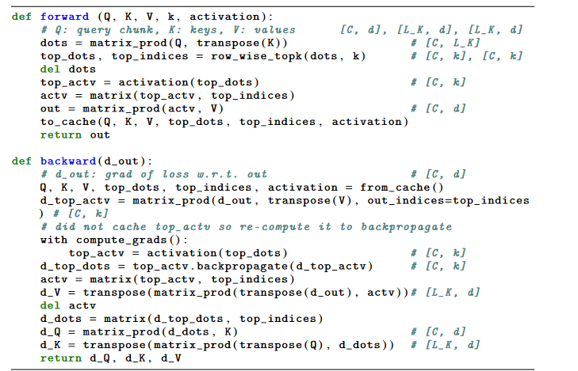
Related Work
SustainNLP Jun 13 2021
Memory-efficient Transformers via Top-k Attention
Notes:
The first one is from Google, they propose a topk attention method that only select a subset of key values to the apply the attention.
Similar to the standard attention ,first compute the dot product from key and query

Slide 24
Related Work
SustainNLP Jun 13 2021
Memory-efficient Transformers via Top-k Attention
Notes:
Then select the topk dot product for each query

Slide 25
Related Work
SustainNLP Jun 13 2021
Memory-efficient Transformers via Top-k Attention
Notes:
The activation here include the scale and mask

Slide 26
Related Work
SustainNLP Jun 13 2021
Memory-efficient Transformers via Top-k Attention
Notes:
Then, select the corresponding values and do the dot product

Slide 27
Related Work
SustainNLP Jun 13 2021
Memory-efficient Transformers via Top-k Attention
Notes:
After that, save the query, key, values as well as top indices to the cache

Slide 28
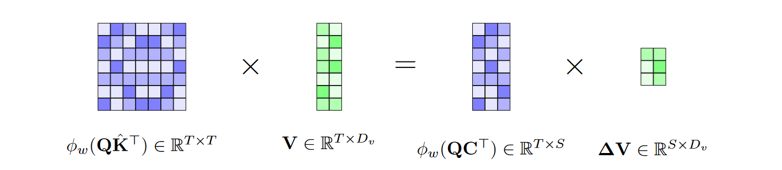
Related Work
ArXiv 2023
Transformer-VQ: Linear-Time Transformers via Vector Quantization
Notes:
The second work, Transformer-VQ. It is similar to my first idea, they use cluster centers to quantizied the kvcache
To reduce the attention cost
There the C is the centeres of keys and \Delta V is the grouped sum of values

Slide 29
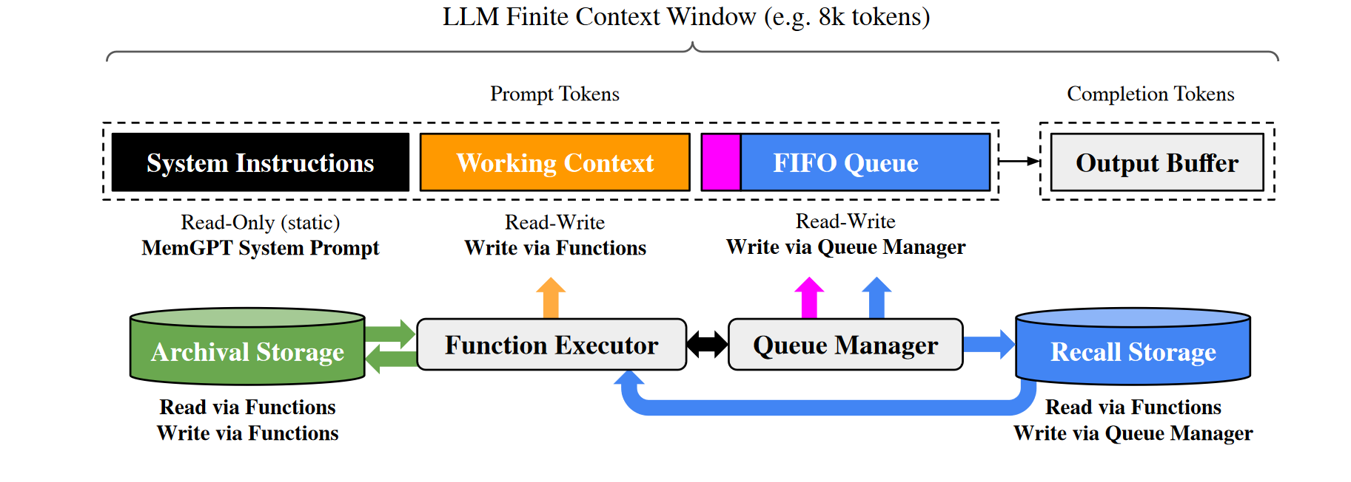
Related Work
ArXiv 2024
MemGPT: Towards LLMs as Operating System
Notes:
The third work, MemGPT is a kind of RAG method to enable long context generation ,
The prompt is made up of three components, that is, system instructions, working context and FIFO queue,
The system instruction is fixed like an operation system.
The difference between working context and FIFO queue is that the working context is written explicitly via function, while FIFO queue is written implicitly via queue manager

Slide 30
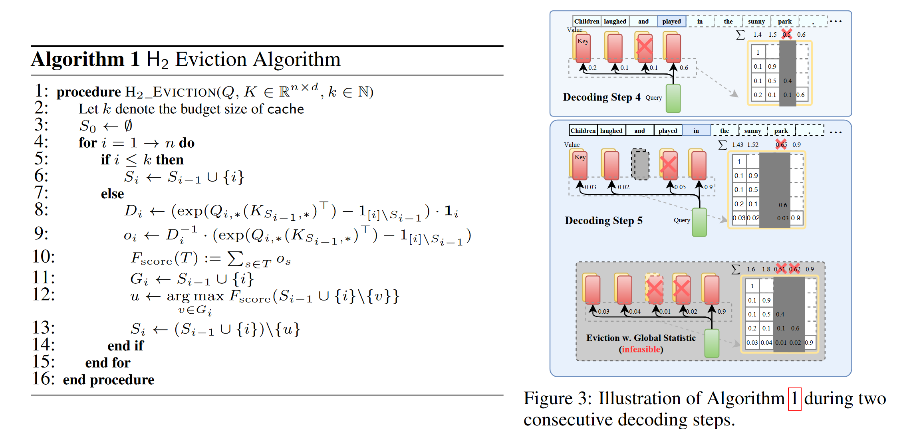
Related Work
NeurIPS Dec 18 2023
H2O: Heavy-Hitter Oracle for Efficient Generative Inference of Large Language Models
Notes:
Apart from that, there are also methods that drop tokens dynamically.
For example, the H2O, Heavy-Hitter Oracle. It will drop the key value that is less noticed by the attention.
During the inference, it will calculate the summation of attention for each query,
Then, it will keep a finite amount of tokens and drop thoese with low summation attention.
However, it only apply to MHA rather than the GQA which is used by Llama3

Slide 31
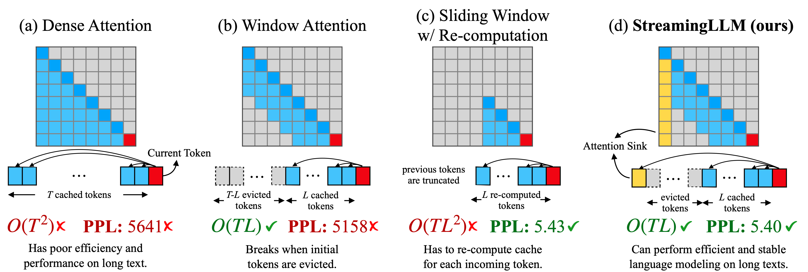
Related Work
ICLR May 2024
Efficient Streaming Language Models with Attention Sinks
Notes:
The StreamLLM, is more intuitive, the auther found that only the first few tokens and last few tokens are of high attention.
So they only keep the first few tokens and a sliding window in the inference stage.
The yellow part is the first few start tokens, and blue part is the sliding window, the red is the current query.

Slide 32
Related Work
ICLR May 2024
Efficient Streaming Language Models with Attention Sinks
Notes:
The StreamLLM, is more intuitive, the auther found that only the first few tokens and a sliding window are of high attention.
So they only keep the first few tokens and a sliding window in the inference stage.
The red part is the first few start tokens, and blue part is the sliding window, the red is the current query.
As for comparison, on the left, the dense attention has an infinite large window.

Slide 33
Related Work
ICLR May 2024
Efficient Streaming Language Models with Attention Sinks
Notes:
The StreamLLM, is more intuitive, the auther found that only the first few tokens and a sliding window are of high attention.
So they only keep the first few tokens and a sliding window in the inference stage.
The red part is the first few start tokens, and blue part is the sliding window, the red is the current query.
As for comparison, on the left, the dense attention has an infinite large window.
For each query in the window attention, it will do attention to all the previous tokens inside the window size.

Slide 34
Related Work
ICLR May 2024
Efficient Streaming Language Models with Attention Sinks
Notes:
And, Sliding Window with Re-computation rebuilds the KV states from the L recent tokens for each new query.

Slide 35
1. Related Work
2. Observation
3. Methodology
4. Experiment
5. Conclusion

Slide 36
1. Related Work
2. Observation
3. Methodology
4. Experiment
5. Conclusion
Notes:
Now, let’s do some basic experiments.

Slide 37
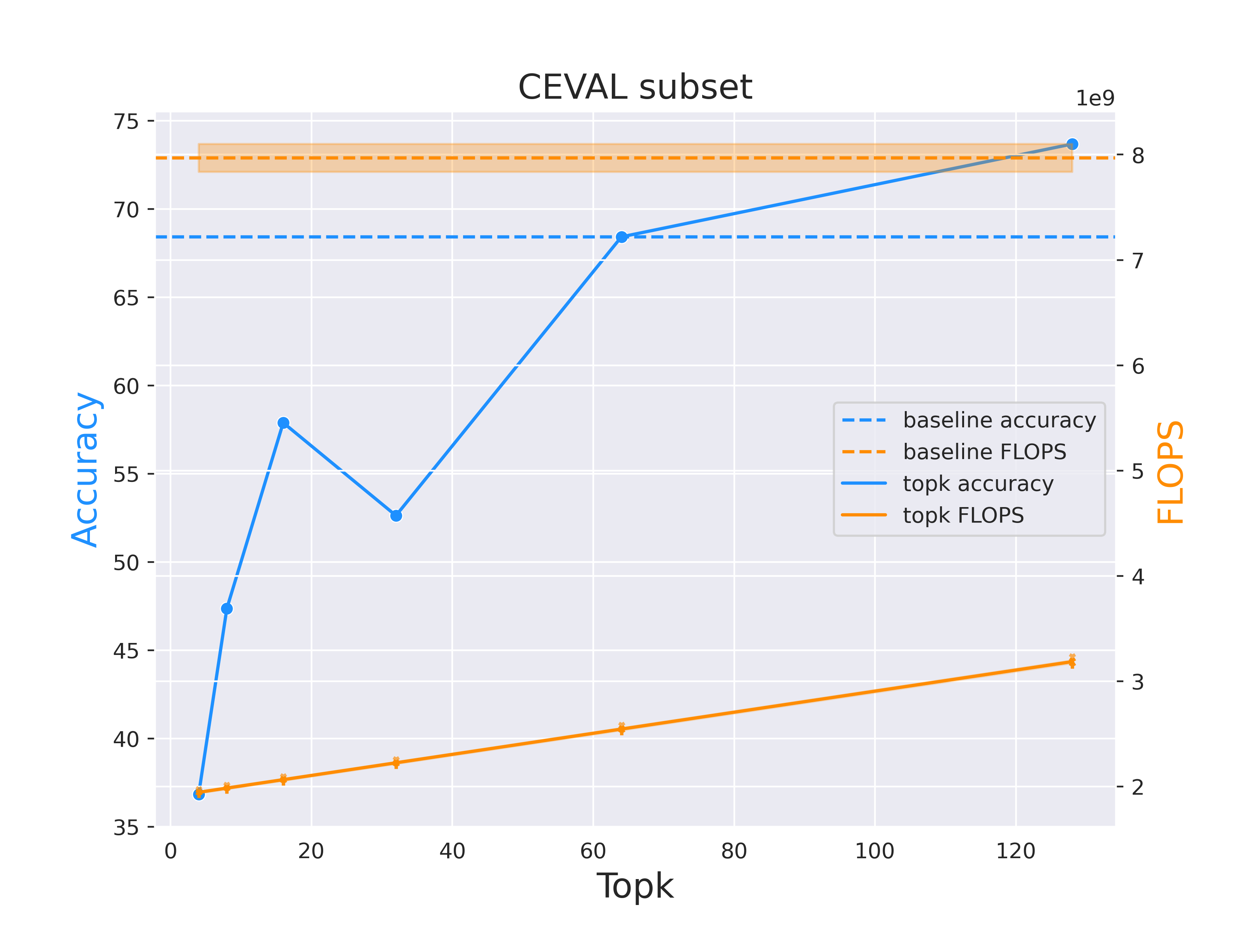
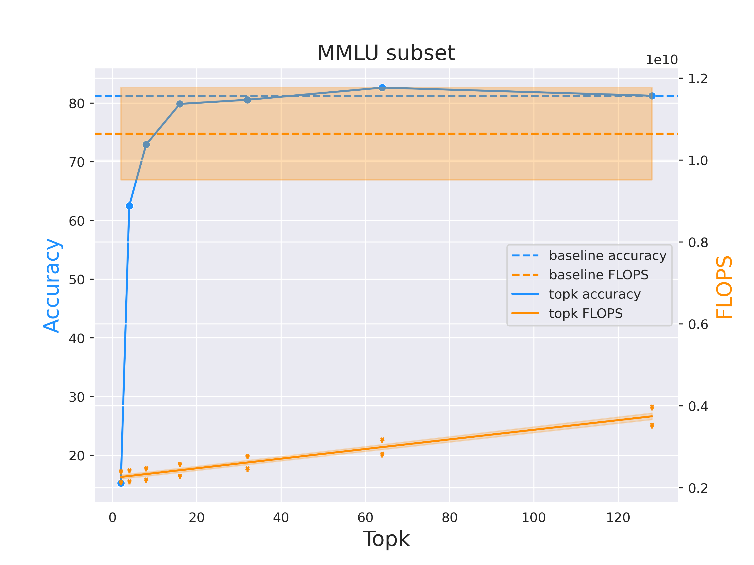
Topk attention is pretty good
Notes:
First , we test the topk attention on two datasets, that is the Ceval subset and mmlu subset.
The topk attention is to select the most weighted topk key value to apply the attention rather than the whole kvcache.
It’s obvious that the topk attention perform so well compared to the baseline, which is the flash attention.
The topk can achieve the performance of the baseline at high topk, but still lower flops compared to the standard attention
By the way, the topk attention is the upper bound for the token dropping methods

Slide 38

Attention Matrix Visualization
Notes:
How does the attention matrix looks like?
Here is the first layer attention matrix for Llama3 Instruct 8B model on MMLU dataset.
As you can see, almost nothing,
Because the color is too inconspicuous.

Slide 39
Attention Matrix Visualization
Notes:
How does the attention matrix looks like?
Here is the first layer attention matrix for Llama3 Instruct 8B model on MMLU dataset.
As you can see, almost nothing,
Because the color is too inconspicuous.
You can see it only if you zoom in for 10 times!

Slide 40
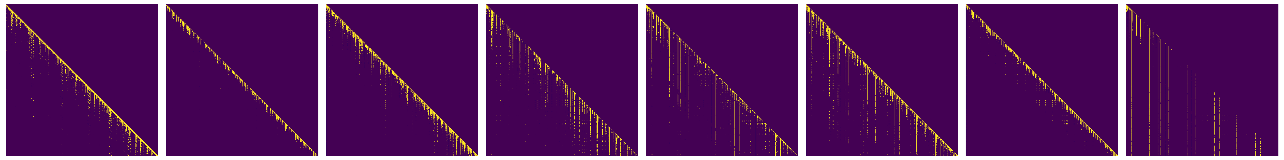
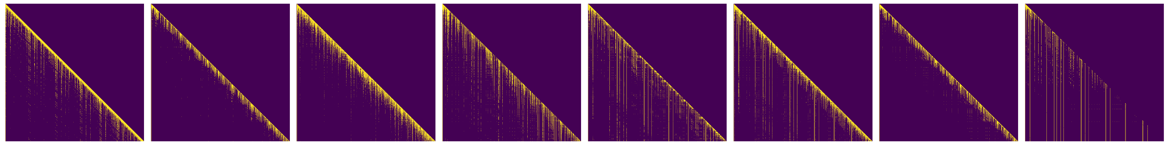
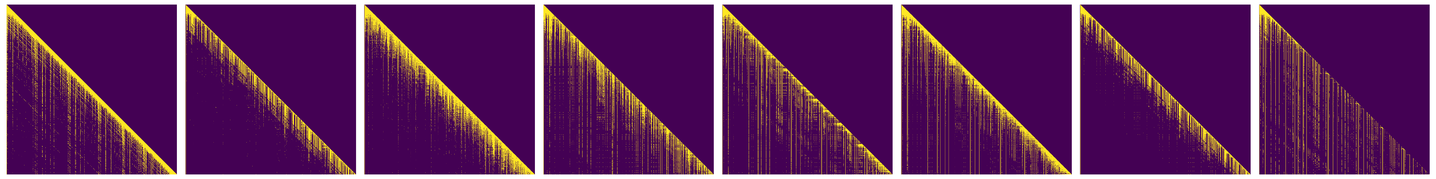
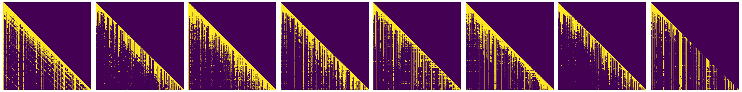
Attention Matrix Visualization
Head 0
Head 1
Head 2
Head 3
Head 4
Head 5
Head 6
Head 7
Top8
Top16
Top32
Top64
Notes:
So here, we introduce a new visualization method
----The topk attention matrix
Which highlight the tokens with the topk most attention for each query
Because Llama3 use GQA, so here each head is actually corresponding to 4 heads in MHA

Slide 41
Attention Matrix Visualization
What does it mean?
Different Topk [8,16,32,64] for the first layer for different head on MMLU dataset
Why does it look more dense than topk?
Because of GQA, there are four query for one key. So I add them together
What model do and dataset do we use ?
Llama3-Instruct 8B on MMLU subsample (college_biology).
In GQA there are multiple query corresponding to one head, why it’s not shown here?
We did a logical or reduction inside the group
What’s the relationship between topk matrix and attention matrix?
It can be considered as different contrast of image for the attention matrix
Notes:
So what does this figure mean?
It means that the attention matrix with different topk for the first layer of Llama3 instruct 8B model on MMLU dataset
Someone may ask, why does it look more dense than k?
Because they may think, you should have 8 light pixel in a row when the topk is 8.
But here, because of the group query attention of llama3, we did a logical or reduction inside each group.
And What’s the relationship between topk matrix and attention matrix?
Well, the topk attention matrix can be considered as different contrast of image for the attention matrix

Slide 42
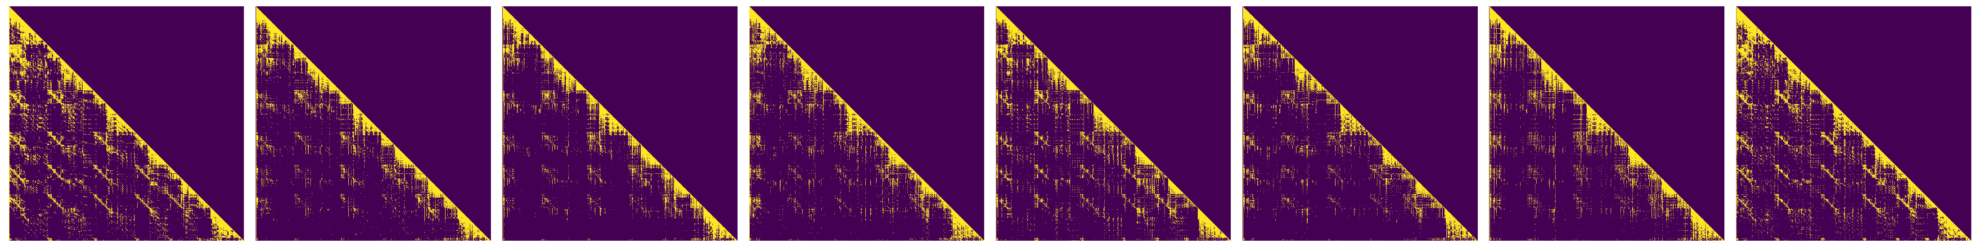
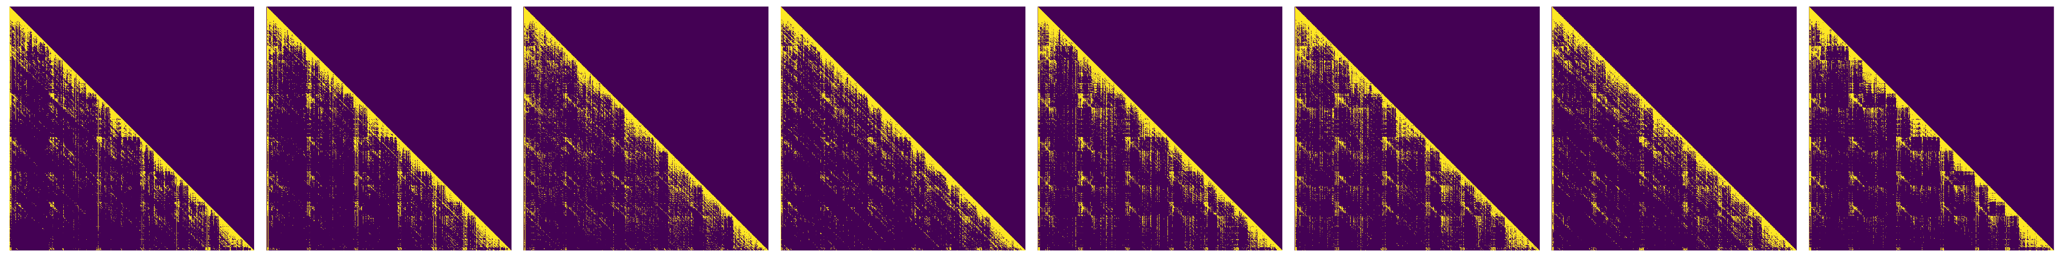
Attention Matrix Visualization
Head 0
Head 1
Head 2
Head 3
Head 4
Head 5
Head 6
Head 7
Layer0
Layer15
Layer31
Notes:
How does different layer’s topk attention looks like?
Here is the top32 attention matrix for the first, middle and last layer

Slide 43
Attention Matrix Visualization
What does it mean?
Different Layer [0, 15, 31] at topk = 32 for different head
What’s the difference from the last one?
Last one is for one layer with different topk, here is different layer with same topk
What can we got ?
Shallow layers have different attention pattern compared to deep one
Shallow pattern looks more continuous while deep ones look to be chunked
Notes:
There is an interesting finding, that shallow layers seems to have different pattern compared to deeper layers

Slide 44
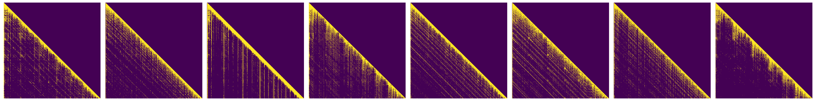
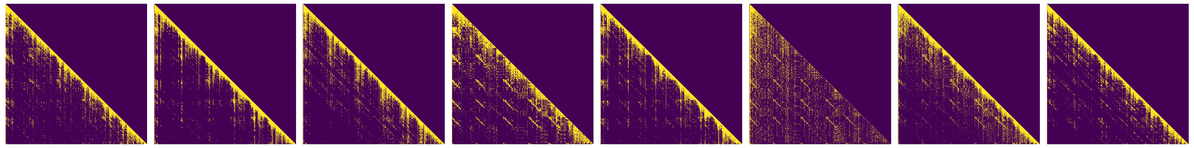
Attention Matrix Visualization
Head 0
Head 1
Head 2
Head 3
Head 4
Head 5
Head 6
Head 7
Layer0
Layer1
Layer2
Notes:
Let’s check when does the deeper layer’s pattern appear.
Here is the top32 attention matrix for the first three layeres .

Slide 45
Attention Matrix Visualization
What does it mean?
Different Layer [0, 1, 2] at topk = 32 for different head
What’s the difference from the last one?
The layers are different, here we want to look at shallow layers
What can we got ?
The absolute chunked pattern appear from layer 1(first head and last head)
Relative chunked pattern appear from layer 2
Notes:
So what can we got?
The absolute chunked pattern appear from layer 1(which is the second layer)
Relative chunked pattern appear from layer 2(which is the third layer)

Slide 46
Pattern Observation
Head 0
Head 1
Head 2
Head 3
Head 4
Head 5
Head 6
Head 7
Layer0
Layer1
Layer2
Notes:
All attention matrices consist of some basic patterns

Slide 47
Pattern Observation
Pattern 1.1 : Token Absolute Position
Each query focus on few fixed previous tokens
Notes:
The first one is the token absolute positions, that each query focus on few fixed previous tokens

Slide 48
Pattern Observation
Head 0
Head 1
Head 2
Head 3
Head 4
Head 5
Head 6
Head 7
Layer0
Layer1
Layer2
Notes:
The seconnd one is the token relative positions, that each query focus on a dilated sliding window

Slide 49
Pattern Observation
Pattern 1.2 : Token Relative Position
Each query focus on a dilated sliding window
Notes:
The seconnd one is the token relative positions, that each query focus on a dilated sliding window

Slide 50
Pattern Observation
Head 0
Head 1
Head 2
Head 3
Head 4
Head 5
Head 6
Head 7
Layer0
Layer1
Layer2
Notes:
The third one is the chunk absolute positions, each query focuses on a few fixed tokens at the beginning of each chunk.

Slide 51
Pattern Observation
Pattern 2.1 : Chunk Absolute Position
Each query focus few frist fixed tokens of each chunks
Notes:
The third one is the chunk absolute positions, each query focuses on a few fixed tokens at the beginning of each chunk.

Slide 52
Pattern Observation
Pattern 2.2 : Chunk Relative Position
Each query focus the first few diagonal of each chunks
Notes:
In another pattern, each query focuses on the first few diagonals within each chunk.

Slide 53
Pattern Observation
How to get the chunks?
Notes:
The next question is How to get the chunks?
Because the start few tokens for chunks is more likely to be reused by the topk attention.
Therefore, we’d like to find where is the beginning of the chunks

Slide 54
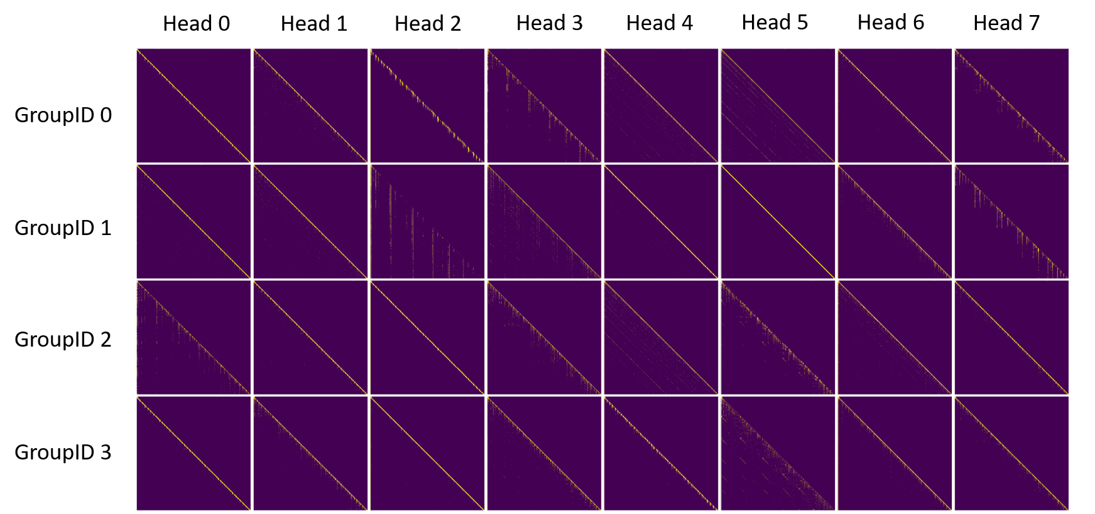
Pattern Detection
Notes:
Well, let’s look back into the top8 attention matrix at layer 1(which is the second layer)

Slide 55
Pattern Detection
What does it mean?
Top8 Attention matrix for different query in the GQA for layer 1(second layer)
What can we got ?
Some query, key could tell us where the chunk is
Notes:
In this figure, some attention matrix tells us how to find the chunks

Slide 56
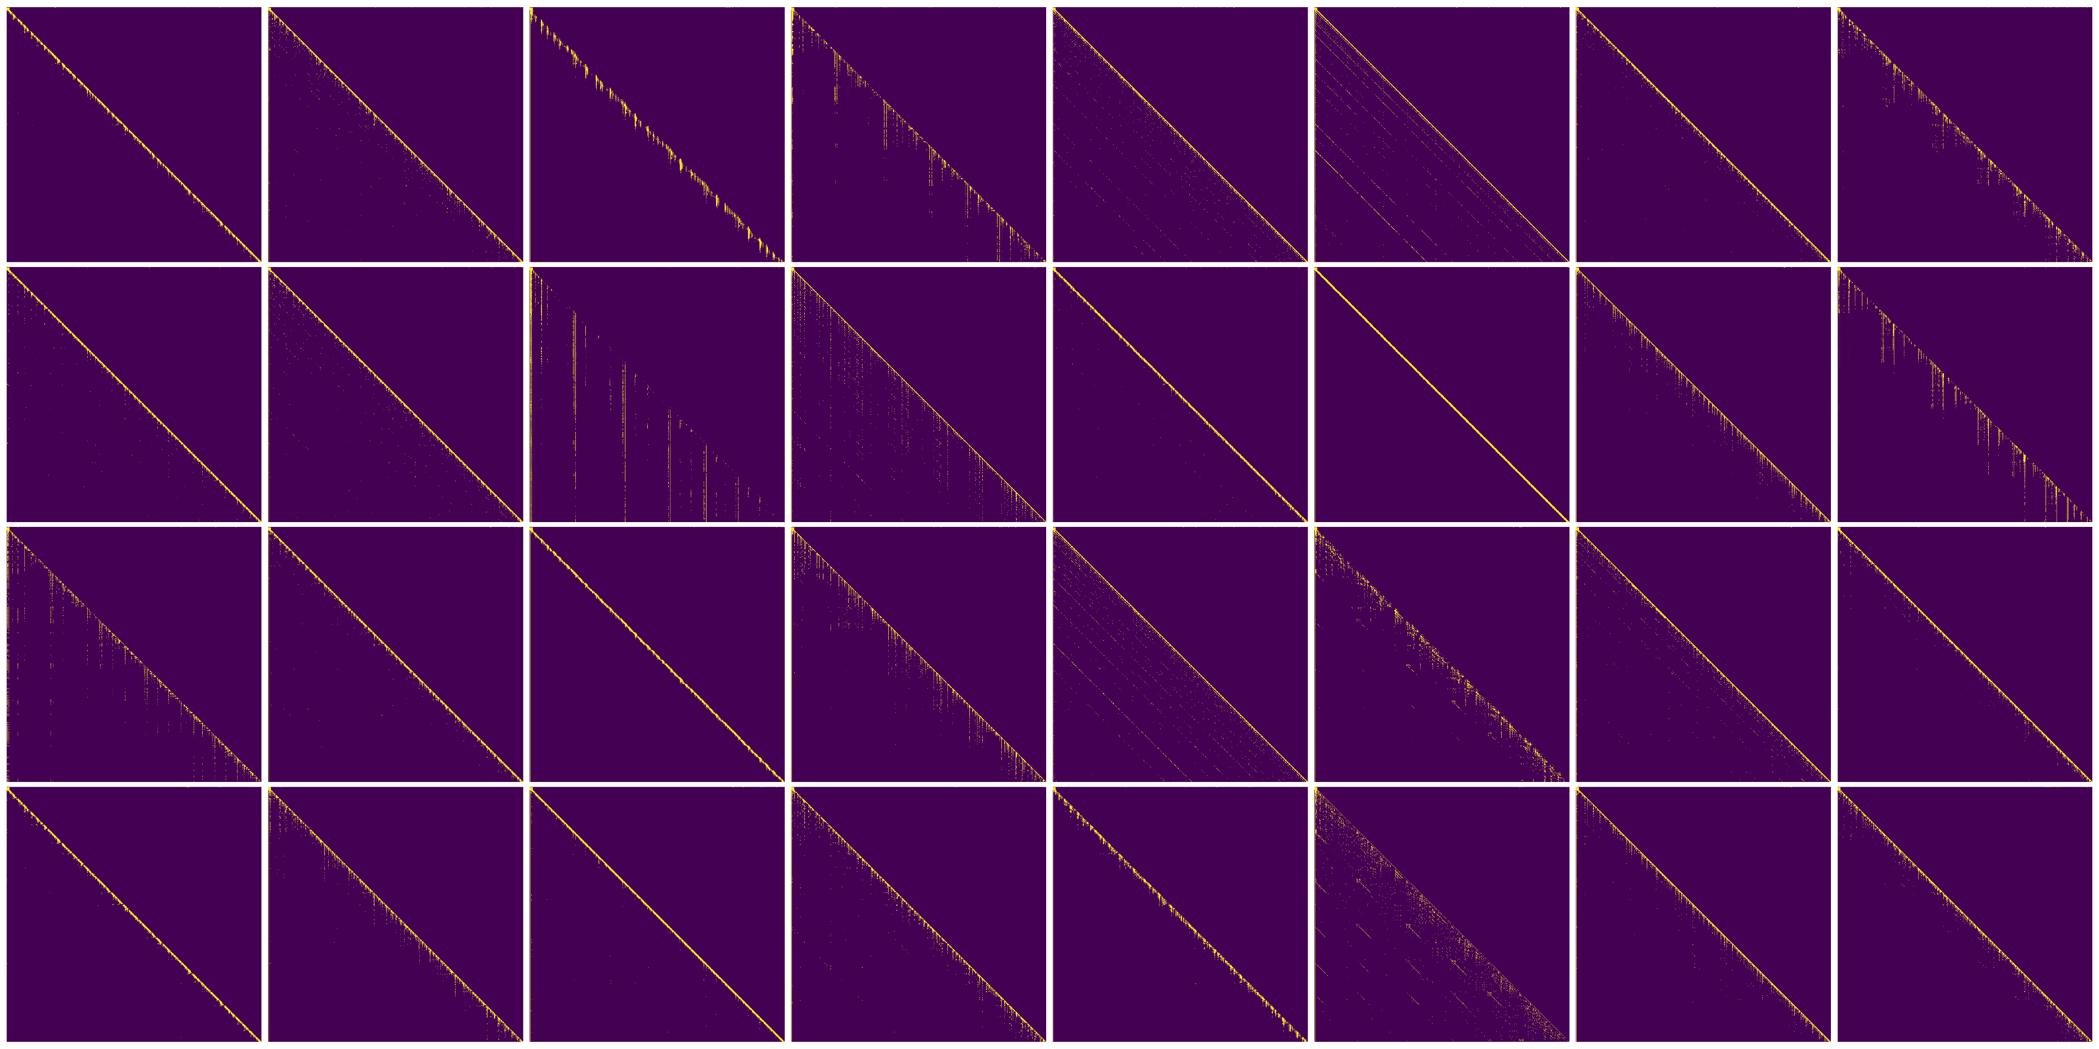
Pattern Detection
Head 0
Head 1
Head 2
Head 3
Head 4
Head 5
Head 6
Head 7
GroupID 0
GroupID 1
GroupID 2
GroupID 3
Notes:
For the attention matrix at layer 1 head 2 with groupID 1.

Slide 57
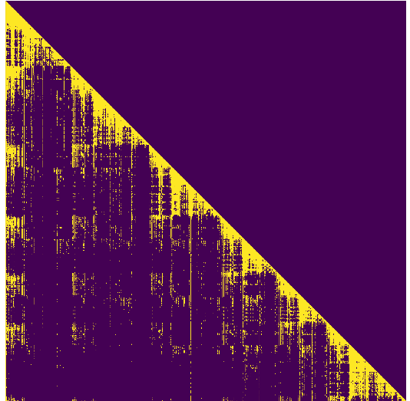
Pattern Detection
Layer 1
Head 2
GroupID 1
Notes:
It has some fixed highlighted tokens for each query

Slide 58

Pattern Detection
Notes:
We calculate the col sum for the attention matrix on the right. The peaks corresponding to the start of a chunk.
In this way, we could try to reuse those start tokens by utilizing the chunks partition

Slide 59

Pattern Detection
Notes:
However, it’s hard to find the peaks in dynamic scenarios. It’s a stream peak finding problem.

Slide 60

Pattern Detection
Notes:
Here is the algorithm to find the left edge of the peak, it’ used to find the start of the chunk.
First we find all the peaks,

Slide 61
Pattern Detection
Notes:
Here is the algorithm to find the left edge of the peak, it’ used to find the start of the chunk.
First we find all the peaks,
Then do the DBSCAN clustering for the peaks.

Slide 62
Pattern Detection
Notes:
Here is the algorithm to find the left edge of the peak, it’ used to find the start of the chunk.
First we find all the peaks,
Then do the DBSCAN clustering for the peaks.
The minimum points in the cluster is the left edge of the peaks

Slide 63
Pattern Detection
What are those peaks stand for?
Notes:
Well, What Text Do These Peaks Correspond To?

Slide 64
Text Correspondence
<|begin_of_text|><|start_header_id|>user<|end_header_id|>
There is a single choice question about college biology. Answer the question by replying A, B, C or D.
Question: Which of the following represents an accurate statement concerning arthropods?
A. They possess an exoskeleton composed primarily of peptidoglycan.
B. They possess an open circulatory system with a dorsal heart.
C. They are members of a biologically unsuccessful phylum incapable of exploiting diverse habitats and nutrition sources.
D. They lack paired, jointed appendages.
Answer:<|eot_id|><|start_header_id|>assistant<|end_header_id|>
B<|eot_id|><|start_header_id|>user<|end_header_id|>
There is a single choice question about college biology. Answer the question by replying A, B, C or D.
Question: In a given population, 1 out of every 400 people has a cancer caused by a completely recessive allele, b. Assuming the population is in Hardy-Weinberg equilibrium, which of the following is the expected proportion of individuals who carry the b allele but are not expected to develop the cancer?
A. 1/400
B. 19/400
C. 20/400
D. 38/400
Answer:<|eot_id|><|start_header_id|>assistant<|end_header_id|>
D<|eot_id|><|start_header_id|>user<|end_header_id|>
There is a single choice question about college biology. Answer the question by replying A, B, C or D.
Question: The presence of homologous structures in two different organisms, such as the humerus in the front limb of a human and a bird, indicates that
A. the human and bird are polyphyletic species
B. a human's and bird's evolution is convergent
C. the human and bird belong to a clade
D. the human and bird developed by analogy
Answer:<|eot_id|><|start_header_id|>assistant<|end_header_id|>
C<|eot_id|><|start_header_id|>user<|end_header_id|>
There is a single choice question about college biology. Answer the question by replying A, B, C or D.
Question: According to the pressure-flow model of movement of phloem contents, photosynthate movement from source to sink is driven by
A. an ATP-dependent pressure-flow pump
B. a water-pressure potential gradient
C. transpiration
D. apoplastic diffusion
Answer:<|eot_id|><|start_header_id|>assistant<|end_header_id|>
B<|eot_id|><|start_header_id|>user<|end_header_id|>
There is a single choice question about college biology. Answer the question by replying A, B, C or D.
Question: Which of the following contain DNA sequences required for the segregation of chromosomes in mitosis and meiosis?
A. Telomeres
B. Centromeres
C. Nucleosomes
D. Spliceosomes
Answer:<|eot_id|><|start_header_id|>assistant<|end_header_id|>
B<|eot_id|><|start_header_id|>user<|end_header_id|>
There is a single choice question about college biology. Answer the question by replying A, B, C or D.
Question: A female fruit fly bearing linked genes that produce the phenotype gray body and normal wings mates with a male fruit fly of phenotype black body and vestigial wings. The presence of gray-bodied, vestigialwinged flies among the progeny is best explained by
A. crossing over
B. independent assortment
C. segregation of alleles
D. penetrance
Answer:<|eot_id|><|start_header_id|>assistant<|end_header_id|>
Peaks
Notes:
The peaks corresponding to the choices of the questions in MMLU dataset

Slide 65
Text Correspondence
Does it work for other datasets?
Notes:
Another question, Does it work for other datasets?

Slide 66



Dataset Generalization
Notes:
Here we prepare three datasets

Slide 67


Multi-Agent
Layer 1 Head 2 QueryID 1
Notes:
The first one, Multi agent dataset, which simulate the interaction between multiple agents
It also has chunks pattern

Slide 68

Multi-Agent
Notes:
The peaks correspond to the change of the role

Slide 69

ShareGPT
Notes:
For another dataset, the sharegpt. It contains user-shared conversations with ChatGPT
There are also similar peaks patterns

Slide 70

ShareGPT
Notes:
The peaks focus on not only the conjunctions words like “then” or “further”, but also the semantic switching

Slide 71

SuperGLUE
Notes:
The SuperGLUE dataset is a benchmark designed to evaluate the performance of natural language understanding models across a diverse set of challenging tasks.
Chunk patterns are also observed

Slide 72

SuperGLUE
Notes:
The peaks mostly correspond to the whitespace and punct as well as choices

Slide 73
Dataset Generalization
What can we got?
“.”, “\n” and change of the role is always considered as the start of the chunk
Connection words like “then” or “further” also indicates the start of a new chunk
Why is there “âĢĤâĢ” in the paragraph ?
Its caused by the tokenizer
Notes:
And what can we got from these datasets?
First, the punct, newline and role-changing always considered as the start of a chunk.
Second, the connection words also indicate the start of a new chunk

Slide 74
1. Related Work
2. Observation
3. Methodology
4. Experiment
5. Conclusion
Notes:
After got the interesting observations

Slide 75
1. Related Work
2. Observation
3. Methodology
4. Experiment
5. Conclusion
Notes:
After got the interesting observations,
now we’d like to propose new methods to improve the performance of the LLM

Slide 76




Methodology
Diagonal
Sliding Window
Sink
Query
(a) Dense Attention
(b) Window Attention
(c) Stream LLM
(d) Chunk Sink (Ours)
Notes:
Here, we propose a method called chunk sink which only store the first few tokens for each chunk.
Here the yellow part represent the sink, which is a few fixed tokens, and blue part indicates a sliding context like a convolution window.
Compared to streamLLM, chunk sink could remember the information in middle, rather than only the start and end

Slide 77
Methodology
Chunk 1
Chunk 2
Window
Stream LLM
Chunk 1
Chunk 2
Window
Chunk Sink
Sink
Sliding Window
All Token
Notes:
Here is an animation for how the chunk sink work

Slide 78
Methodology
Chunk 1
Chunk 2
Chunk 3
Window
Stream LLM
Chunk 1
Chunk 2
Chunk 3
Window
Chunk Sink
Sink
Sliding Window
All Token
Notes:
When new tokens come in. It store the information within the sink size

Slide 79
Methodology
Chunk 1
Chunk 2
Chunk 3
Window
Stream LLM
Chunk 1
Chunk 2
Chunk 3
Window
Chunk Sink
Sink
Sliding Window
All Token
Notes:
When new tokens come in. It store the information within the sink size

Slide 80
Methodology
Chunk 1
Chunk 2
Chunk 3
Window
Stream LLM
Chunk 1
Chunk 2
Chunk 3
Window
Chunk Sink
Sink
Sliding Window
All Token
Notes:
After the sink size if fullfilled, the incoming tokens will be dropped

Slide 81
1. Related Work
2. Observation
3. Methodology
4. Experiment
5. Conclusion
Notes:
Is this method better than the existing ones?

Slide 82
1. Related Work
2. Observation
3. Methodology
4. Experiment
5. Conclusion
Notes:
Is this method better than the existing ones?
Let’s see in the experiments

Slide 83


Experiment
Token Dropping Methods Compare
Notes:
Here is an experiments benchmarking the streamLLM and chunk sink on CEVAL and MMLU subset.
The x axis is the token percenetage of tokens kept in the inference, which also stands for the memory consumption
Since the chunk sink is static and streamLLM is dynamic, we did not compare the speed here, because it’s unfair for the streamLLM.
As long as we have a dynamic version, we could reach similar speed as the streamLLM

Slide 84
Experiment
Token Dropping Methods Compare
better
better
Notes:
The top left points are better

Slide 85
Experiment
Token Dropping Methods Compare
better
better
Notes:
Our method (which are orange cross here)
could achieve higher accuracy at the same memory consumption

Slide 86
Experiment
Token Dropping Methods Compare
What can we got?
Chunk Sink reach the baseline, at token percentage around 0.5
Chunk Sink seems optimal compared to StreamLLM
Notes:
What can we got?
Chunk Sink reach the baseline, at token percentage around 0.5
Chunk Sink seems optimal compared to StreamLLM

Slide 87




Experiment
Parameter Sensitivity
StreamLLM
Static Chunk
Notes:
We carried out the parameter sensitivity experiments for those methods

Slide 88
Experiment
Parameter Sensitivity
What can we got?
Chunk Sink: The increase in chunk sink contribute little to the performance. It’s more sensitive to the window size
StreamLLM: The StreamLLM is more sensitive to the sink size
Notes:
Also we got some findings
Chunk Sink: The increase in chunk sink contribute little to the performance. It’s more sensitive to the window size
StreamLLM: The StreamLLM is more sensitive to the sink size

Slide 89
1. Related Work
2. Observation
3. Methodology
4. Experiment
5. Conclusion
Notes:
Ok, let’s conclude what we got and what we haven’t

Slide 90
1. Related Work
2. Observation
3. Methodology
4. Experiment
5. Conclusion
Notes:
Ok, let’s conclude what we got and what we haven’t

Slide 91
Conclusion
Limitation
It’s currently a static method which requires precomputation from attention matrix
The chunk sink should be specially design for batch inference
Notes:
First is the limitation
The chunk sink method is currently a static method which requires precomputation from attention matrix
And also, the chunk sink method is hard to apply it in batch inference, because for different sentences, the chunk is different.

Slide 92
Conclusion
Contribution
We conducted a detailed investigation of the attention matrix, uncovering four primary patterns.
We proposed a novel approach, Chunk Sink, which achieves higher accuracy with minimal memory consumption
Notes:
As for the contribution,
We conducted a detailed investigation of the attention matrix, uncovering four primary patterns.
We proposed a novel approach, Chunk Sink, which achieves higher accuracy with minimal memory consumption

Slide 93
Conclusion
Further Work
A stream version of peak detection method should be develop to enable dynamic scenarios
A method utilize all these four patterns
Notes:
As for the future
We should propose a stream version of peak detection to enable dynamic Chunk Sink.
And also we should propose a method using all these four patterns we found in the attention matrix

Slide 94
Thanks for your attention!
Notes:
Ok, thanks for your listening,
That’s the end of the presentation

Slide 95


Mingyuan Chi
Master Thesis
minchi@student.ethz.ch
ETH Zürich
Department of Mathematics Computational Sci & Eng Zürich
Notes:
Too fast
Slides less populated
Talk about the content on the slides (e.g. Transformer VQ) , do not talk things that not on the slides
Compress content

Slide 96
-1. Appendix

Slide 97
Introduction
LLM Specific Task
General LLM to specific task
Long Context depends on the task
Necessity of long context
An example of long context scenarios(motivate long context)
Train
Finetune
RAG
Prompt
Expensive
but Efficient
Cheap
But Insufficient
Notes:
When one want to apply LLM to specific task,
There are many methods could be used, can
Since the machine is limited,
For example, you only have your 24 GB 4090
But you still want your ai assistant to remember what you said in the past few days.
There are many existing solutions.
On the left side, you could train a new model like Mamba to get rid of the kvcache
On the right side, you could use methods like Retrieval Augmented Generation to select the most relevant context instead of using all of them.
However, keep in mind that there is a trade-off between the cost and efficiency.
We’ll talk about some examples in the next chapter

Slide 98

Attention for MMLU

Slide 99

Attention for MMLU

Slide 100

Attention for MMLU

Slide 101

Attention for MMLU

Slide 102

Attention for MMLU

Slide 103

Attention for MMLU

Slide 104

Attention for MMLU

Slide 105

Attention for MMLU

